Slide 1
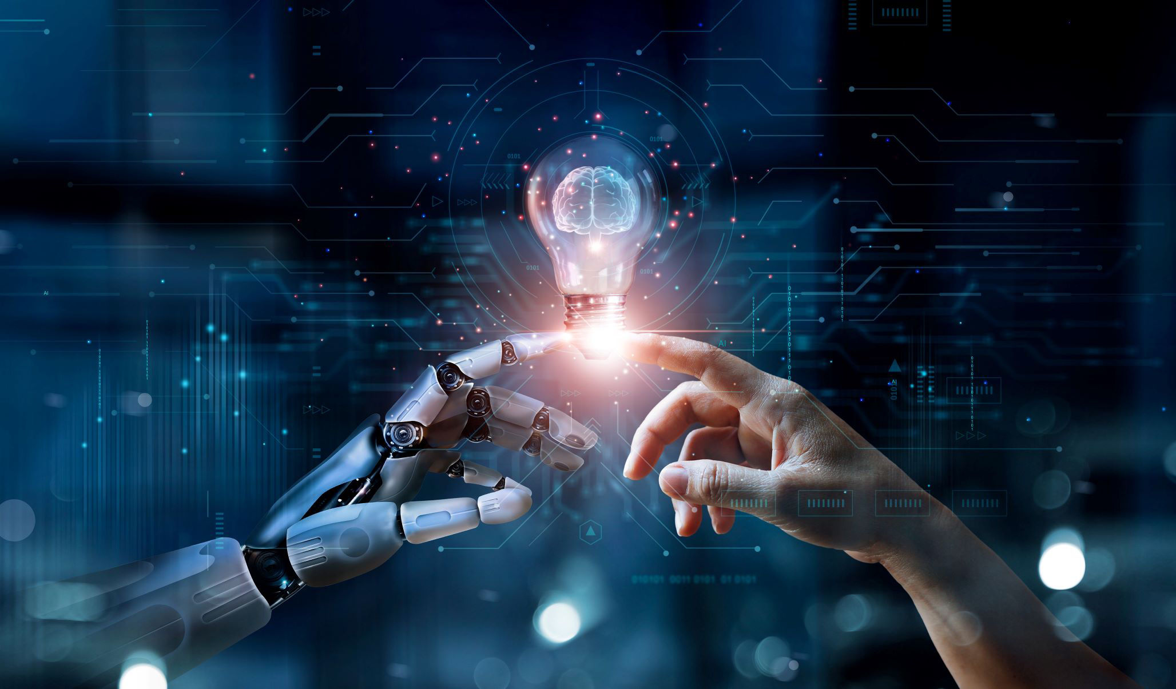
Text To Image Generation
Using Pre-trained Stable Diffusion Model with COCO Captions
Artificial Intelligence IA-2
Team Members: Ronak Rathod: 16010122156
Vedant Rathi: 16010122154
Hyder Presswala: 16010122151
Batch: A4

Slide 2
Index
1)
2)
3)
4)
5)
6)
7)
8)
9)
10)
11)
12
Introduction
What is Text-to-Image Generation?
Introduction to Stable Diffusion
About the COCO Captions Dataset
Tools Used: Hugging Face & PyTorch
Model Architecture Overview
Implementation Steps
Code Snippet
Sample Prompts
Generated Images
Applications
Conclusion

Slide 3
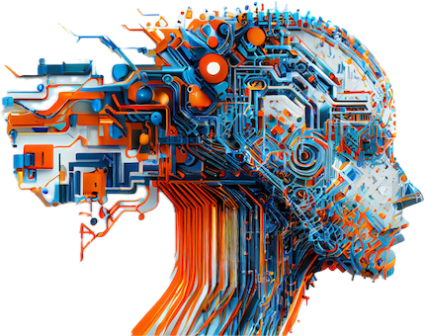
Introduction
Text-to-image generation is an AI task that translates natural language descriptions into coherent and realistic images. This involves understanding context, semantics, and style from textual input. It has rapidly advanced thanks to models like Pre-trained Stable Diffusion Model, revolutionizing content creation, design
and automation.

Slide 4
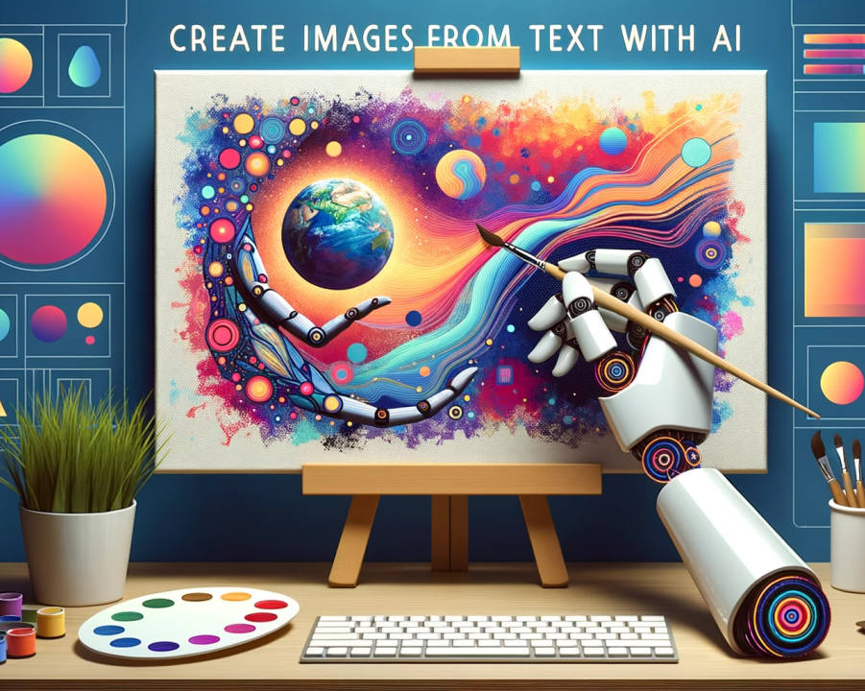
What is Text-to-Image Generation?
Converts a text prompt into a visual image.
Requires NLP + computer vision fusion.
Challenges include handling ambiguity, creativity, and detail.
Applications:
art generation, advertising, prototyping, etc.

Slide 5
Introduction to Stable-Diffusion
Stable Diffusion is a state-of-the-art latent text-to-image generation model developed by Stability AI. Unlike DALL·E, which uses transformer-based autoencoders, Stable Diffusion uses a latent diffusion model that operates in a compressed latent space for efficient and high-quality image generation.
It generates realistic and diverse images from natural language prompts and is available freely through the Hugging Face diffusers library.
Key Features:
Generates high-resolution images using a diffusion-based process
Operates in latent space, making it more memory-efficient
Open-source and runs on consumer-level hardware (CPU/GPU)
Capable of creating photorealistic, artistic, or surreal outputs based on prompts

Slide 6
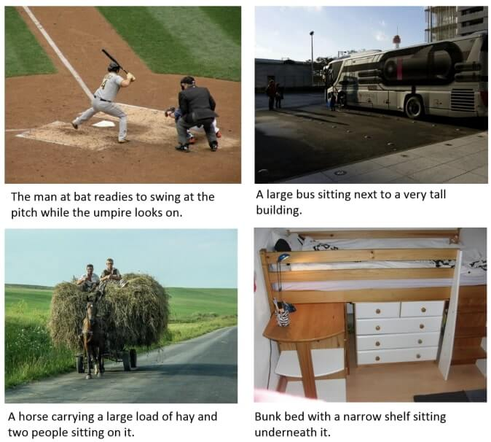
About the COCO Captions Dataset
The COCO (Common Objects in Context) Captions dataset is a large-scale dataset containing images with corresponding textual descriptions. It's widely used for training and evaluating image captioning and generation models.​
Dataset Highlights:
Over 330,000 images.​
Each image has 5 different captions.​
Covers a wide range of everyday scenes and objects.​

Slide 7

Tools Used
Implementing Text-to-Image Generation involves utilizing powerful tools:​
Hugging Face:
Provides pre-trained models and easy-to-use APIs.​
Facilitates model deployment and experimentation.​
PyTorch:
An open-source deep learning framework.​
Offers flexibility and dynamic computation graphs.

Slide 8
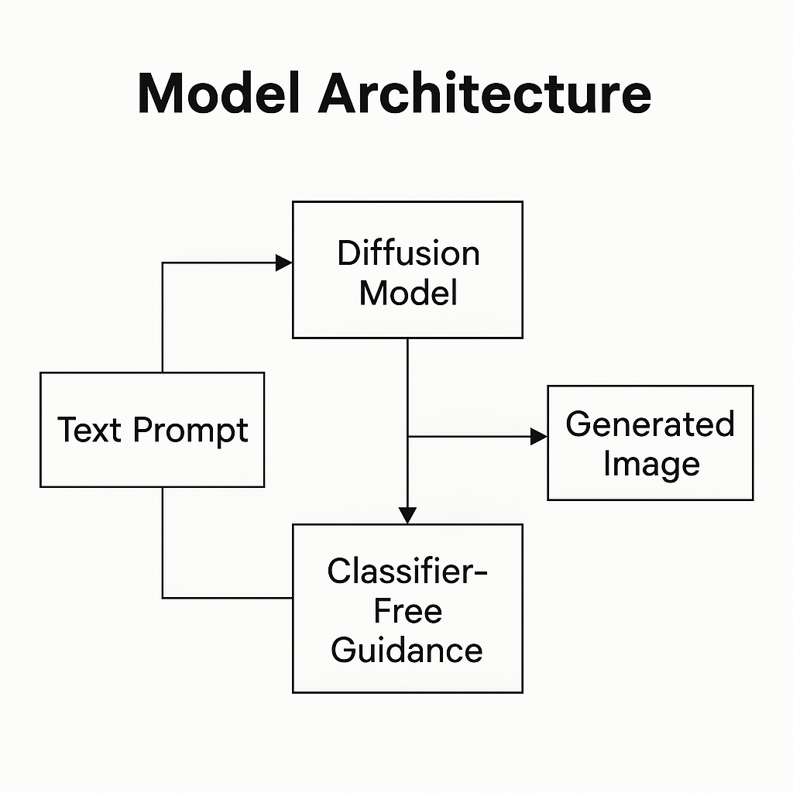
Model Architecture Overview
Input: Text prompt
Tokenizer: Converts text into tokens
Transformer Encoder-Decoder: Understands context & meaning
Image Decoder (VAE or Diffusion-based): Converts encoded representation to image
Output: Synthesized image

Slide 9
Implementation Steps
1. Install Required Libraries: Use pip to install transformers, torch, and datasets for working with the model and data.
2. Load Pre-trained Model: Fetch the Stable Diffusion from Hugging Face's model hub for ready-to-use image generation.
3. Load Dataset: Use the COCO Captions dataset or your own list of text prompts.
4. Tokenize Text: Convert natural language prompts into token format compatible with the model.
5. Generate Image: Pass tokens into the model to generate image outputs.
6. Display/Save Output: Visualize or save the generated images for analysis or presentation.

Slide 10
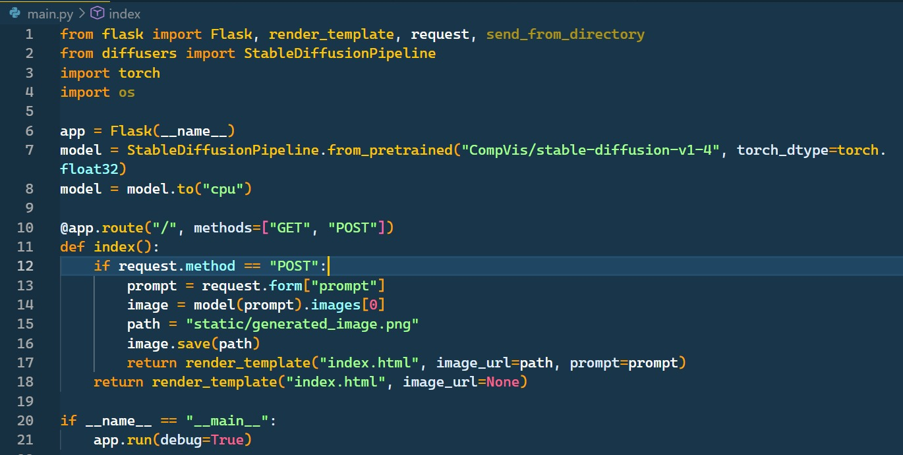
Code Snippet
https://drive.google.com/drive/folders/1EYlwYvDDssUVodO1KYqKWn5gN7-kABKh

Slide 11
Sample Prompts
Prompt 1: "A cat sitting on a beach wearing sunglasses"
Interpretation: A playful and imaginative scenario combining familiar elements (a cat, beach, sunglasses) in an anthropomorphic way.
Why it’s interesting: It tests the model’s ability to understand not only object relationships but also emotional tone (e.g., relaxed or humorous vibes).
Prompt 2: "A bowl of ramen on a floating island in space"
Interpretation: A surreal and creative prompt merging everyday food with a sci-fi environment.
Why it’s interesting: It challenges the model to blend drastically different contexts—culinary realism with cosmic fantasy.

Slide 12
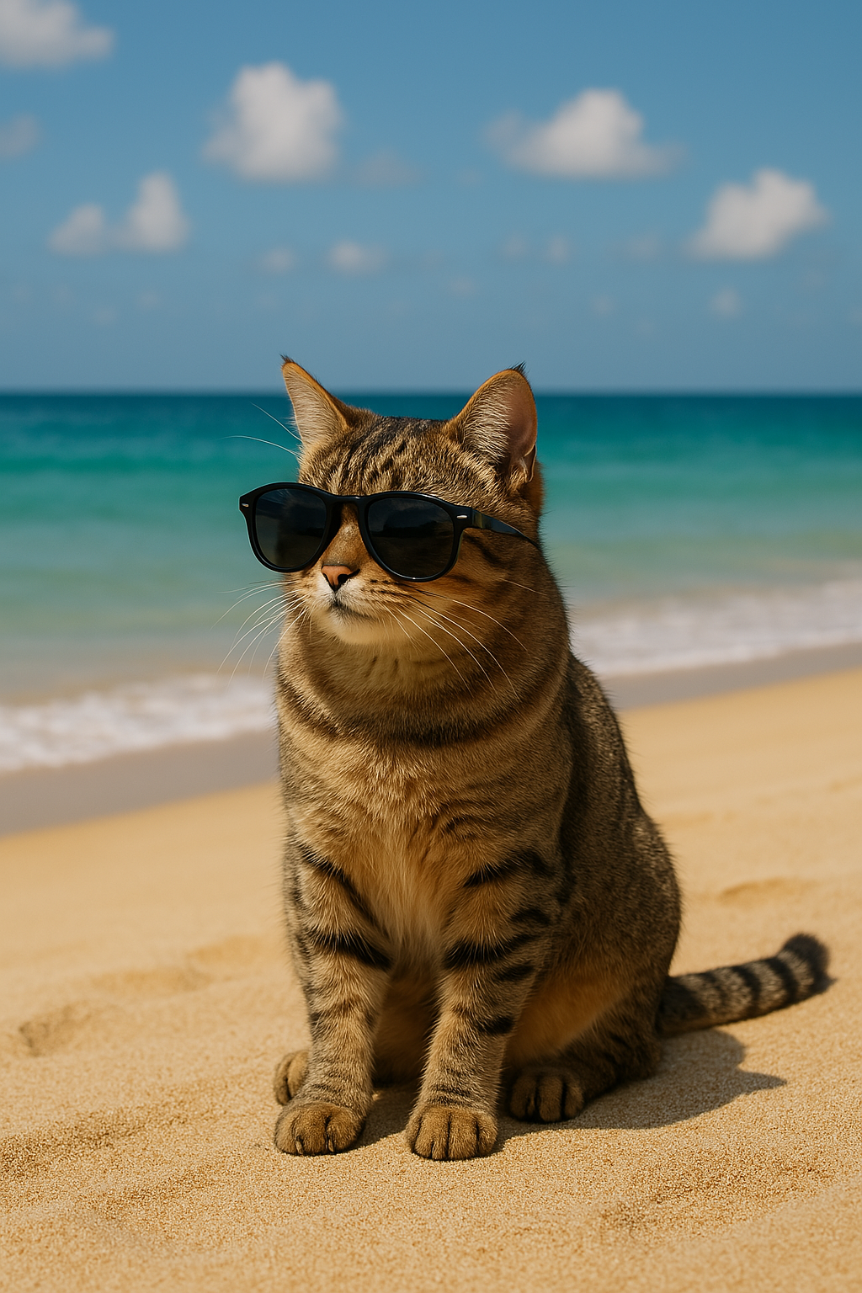
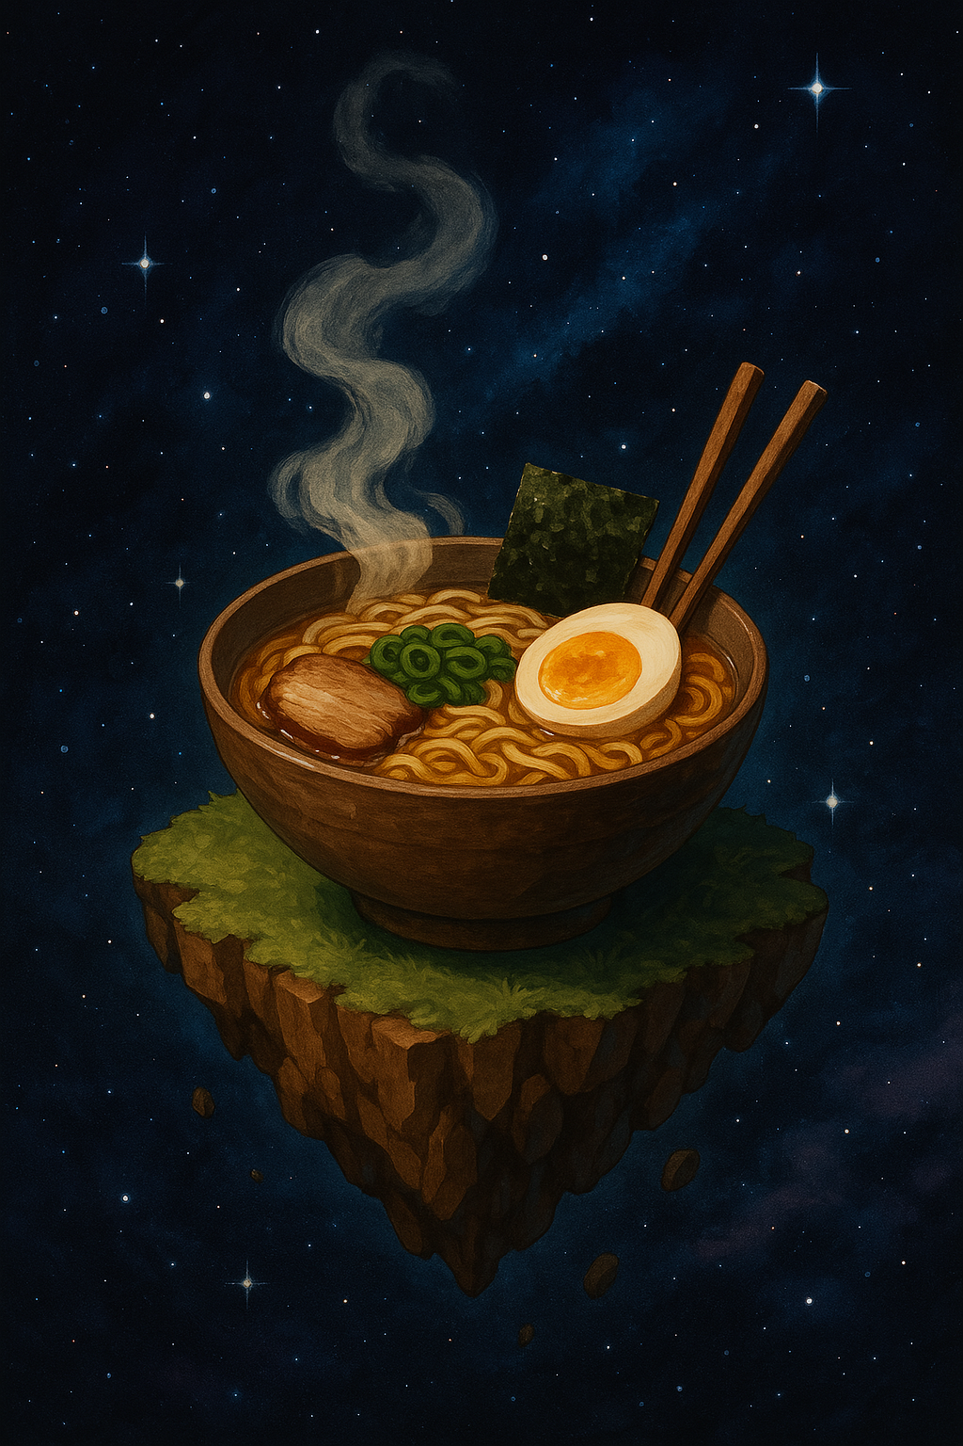
Generated Images
Prompt 1
Prompt 2

Slide 13
Applications
Text-to-Image Generation has diverse real-world applications. It supports artists and designers by instantly visualizing creative ideas, while game developers use it to prototype characters and environments. In marketing and e-commerce, it helps generate personalized product visuals. Educators use it to create engaging learning materials, and it aids accessibility by transforming text into imagery for visually impaired users. Additionally, it enhances storytelling through illustrated content creation and benefits industries like fashion and interior design by visualizing concepts from prompts. Overall, it blends imagination with automation, enabling fast, customized, and scalable visual content generation across multiple domains.

Slide 14
Conclusion
Text-to-image generation exemplifies the power of multimodal AI by combining language understanding with visual imagination. Using models like Stable Diffusion, developers and artists can generate high-quality, coherent images from simple text prompts, all with accessible tools like Hugging Face and PyTorch.
This democratizes creative AI, enabling fast, custom image generation for applications in art, education, design, accessibility, and beyond. As research continues, we anticipate even more intelligent, efficient, and personalized generation systems.

Slide 15
Thank you!

